Slide 1

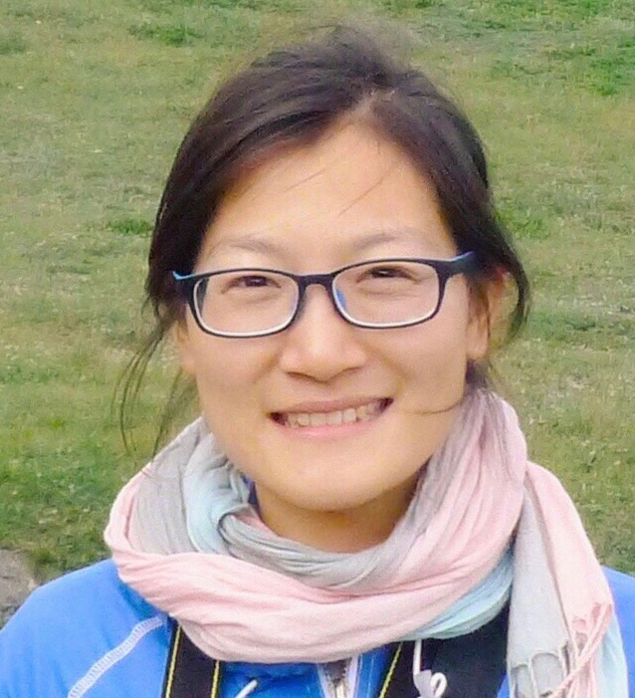

Science is not divided by political borders
Science is not divided by political borders
科学不分国界
科学不分国界
Journal
Huang Zhen
Sustaining Forest Ecosystems
Sustaining Forest Ecosystems
7
Sustaining Biodiversity
Klaus & Marga v. Gadow
13. April, 2021

Slide 2
Hooper et al. (2005):
We are certain of the following:
More species are needed to ensure a stable supply of ecosystem goods and services
We have high confidence in the following:
Practices that maintain a diversity of organisms will help preserve a range of management options
Further research is necessary:
We need long-term experiments to be able to assess temporal stability
Hooper, D. U., F. S. Chapin III J. J. Ewel A. Hector P. Inchausti S. Lavorel J. H. Lawton D. M. Lodge M. Loreau S. Naeem B.
Schmid H. Setälä A. J. Symstad J. Vandermeer D. A. Wardle, 2005: Effects of Biodiversity on Ecosystem Functioning: a
Consaensus of Current Knowledge. Ecological Monographs 75.1: 3-35.

Slide 3
Sustaining Biodiversity
Perspectives
Whittaker’s Hierarchy (α, β, γ)
A world of Anthromes
Toolbox
Richness & Diversity
Relations: SAR & SAD
Sustainable Harvest Events
Future Research
Traits

Slide 4
Whittaker’s Hierarchy
Robert H. Whittaker
γ
β₁₋₃
β₁₋₂
β₂₋₃

Slide 5
Sustaining Biodiversity
Perspectives
Whittaker’s Hierarchy (α, β, γ)
A world of Anthromes
Toolbox
Richness & Diversity
Relations: SAR & SAD
Sustainable Harvest Events
Future Research
Traits

Slide 6
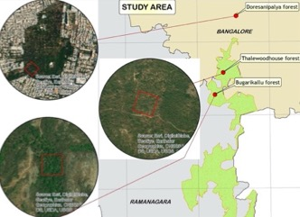
A world of Anthromes
EMPRI

Slide 7
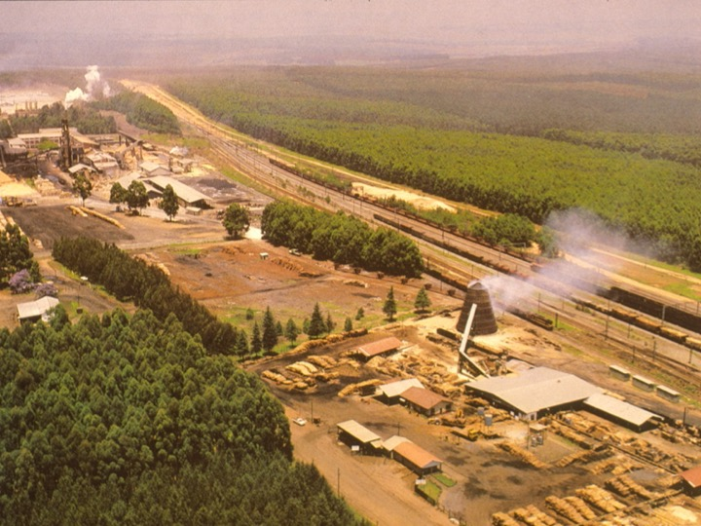
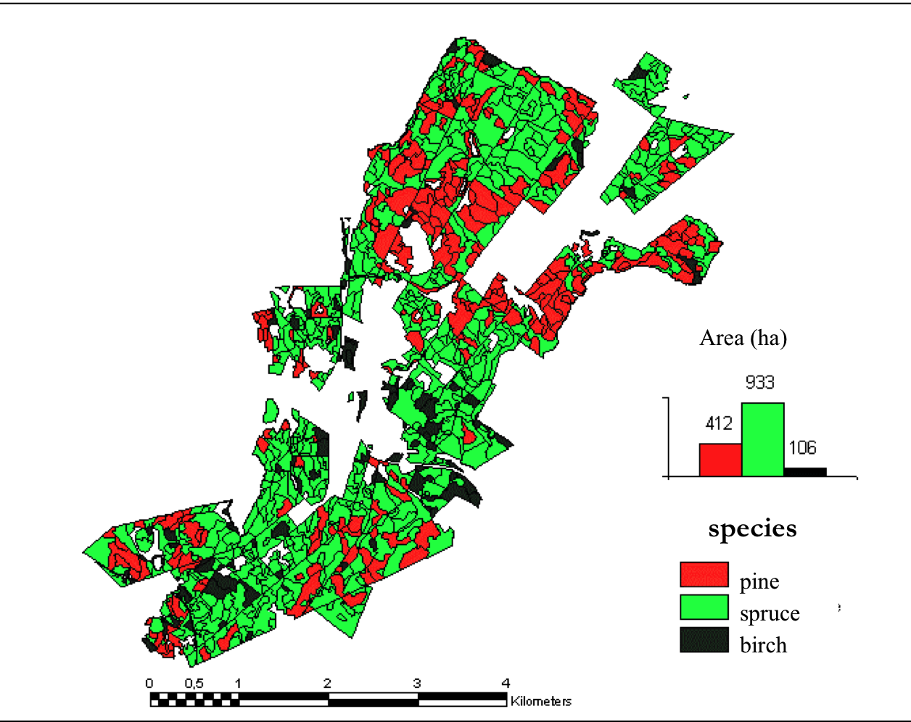
Jordi Garcia-Gonzalo, 2006: Optimisation of Forest Management under current and changing climate: a case study for a Finnish Management Unit. IUFRO Conf. Climate Change, Palencia/Spain.

Slide 8
Sustaining Biodiversity
Perspectives
Whittaker’s Hierarchy (α, β, γ)
A world of Anthromes
Toolbox
Richness & Diversity
Relations: SAR & SAD
Sustainable Harvest Events
Future Research
Traits

Slide 9
Mexico
S=10
China
S=21
Germany
S=3
Richness
S
Diversity
7_PlotSummary.docx

Slide 10
S
H’
e^{H’}
e^{H’}/S
2
0.69
2.00
1.00
A
3
1.01
2.74
0.91
B
3
1.10
3.00
1.00
C

Slide 11
S
H’
e^{H’}
e^{H’}/S
Mx
10
1.8
5.9
0.59
Cn
21
1.0
11.1
0.53
Ge
3
0.9
2.4
0.79
7_Diversity.docx

Slide 12
Spatial Diversity
“group mingling” in close range neighborhoods

Slide 13
Sustaining Biodiversity
Perspectives
Whittaker’s Hierarchy (α, β, γ)
A world of Anthromes
Toolbox
Richness & Diversity
Relations: SAR & SAD
Sustainable Harvest Events
Future Research
Traits

Slide 14
H’ =
a diversity index has no meaning
unless there is a relation to area
Notes:
This is the Shannon index, Confusingly referred to in different ways, e.g. as the Shannon-Weaver, the Shannon-Weiner or the Shannon-Wiener index.
click
The literature on biodiversity seems endless and new ideas continue to emerge.
numerous studies report

Slide 15
S=p1*(1- exp(p2*area))^p3 # asymptotic
S=p1*area^p2 # power
S=(p1*area)/(1+p2*area) # Monod function
Species-Area Relation (SAR)
7_SAR.docx

Slide 16
Species-Area Relation (SAR)
S=(p1*area)/(1+p2*area) # Monod function
Mx
Cn
Ge
Monod, J. 1950: La technique de culture continue, the´orie et applications. Annales de l’Institut Pasteur, 79, 390–410.
Gadow, K. v. and Hui, G. Y., 2007: Can the tree species-area relationship be derived from prior knowledge of the tree species
richness? Forestry Studies / Metsanduslikud Uurimused 46, 13–22, 2007.

Slide 17
Species-Abundance Distribution (SAD)
data: Juan Rommel Baluarte-Vásquez
Plot T7
Peruvian Foodplains

Slide 18
Species-Abundance Distribution (SAD)
7_SAD.docx
Tan L, Zhang P, Zhao X, Fan C, Zhang C, Yan Y, von Gadow K, 2020: Analysing species abundance distribution patterns across
sampling scales in three natural forests in Northeastern China. iForest 13: 482-489. – doi: 10.3832/ifor3211-013 [online 2020-11-01]
Notes:
Some typical shapes, but very scale dependent
interpretations makes sense only in large protected areas.

Slide 19
Sustaining Biodiversity
Perspectives
Whittaker’s Hierarchy (α, β, γ)
A world of Anthromes
Toolbox
Richness & Diversity
Relations: SAR & SAD
Sustainable Harvest Events
Future Research
Traits

Slide 20
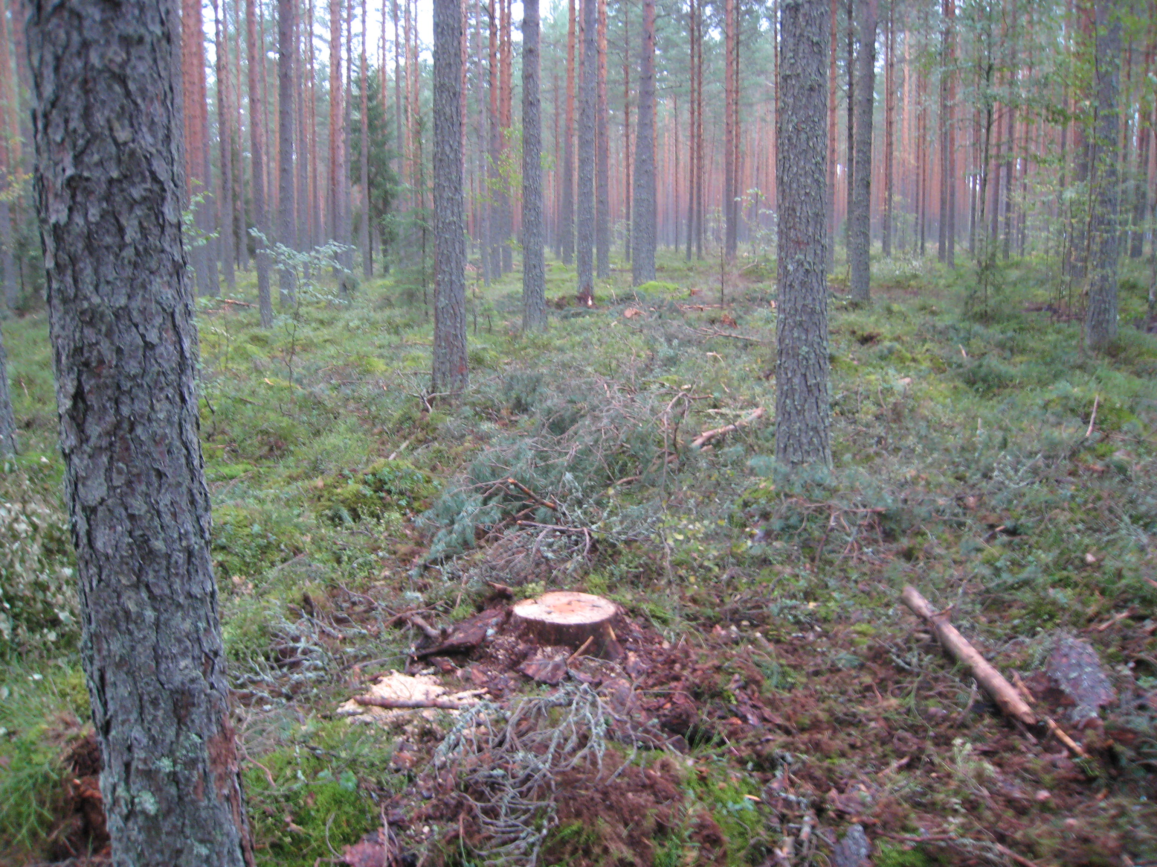
Harvest Event
important element of ecosystem dynamics
Many effects on radiation, soil chemistry, competition, regeneration, tree growth, ground flora, economics, habitat

Slide 21
Harvest Event Analysis
weight/severity
size selectivity
species selectivity
effects on mingling, dominance within neighborhoods

Slide 22
A harvest event in a 2-species forest
NG
2.0
A
1.5
1.0
0.5
B
0
0.2
0.3
0.4
0.5
rG

Slide 23
Acer mono (98/2455 –> pref=0.04)
Pinus koreansis (0/339) –> pref=0.00)
Betula platyph. (7/96) –> pref=0.07)
rG=0.073; rN = 429/27902 = 0.015
NG=1.5/7.3=0.21 (big trees harvested)
Harvest Event
all trees (27902; 10.9 ha)
removed trees

Slide 24
Sustaining Biodiversity
Perspectives
Whittaker’s Hierarchy (α, β, γ)
A world of Anthromes
Toolbox
Richness & Diversity
Relations: SAR & SAD
Sustainable Harvest Events
Future Research
Traits

Slide 25
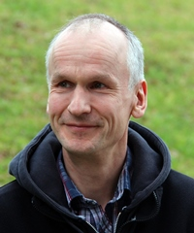
Plant Traits
11,850,781 trait records
Jens Kattge
Hao, Minhui; Kotiganahalli Narayanagowda Ganeshaiah, Chunyu Zhang, Xiuhai Zhao, Klaus von Gadow, 2019: Discriminating among forest communities based on taxonomic, phylogenetic and trait distances. Forest Ecology and Management 440 (2019) 40–47

Slide 26
Biodiversity
Robert H. Whittaker
γ
β₁₋₃
β₁₋₂
β₂₋₃

Slide 27
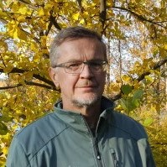
The Program
Theme | Date | Name
Introduction | 2 Mar 2021 | Klaus Gadow
Forest Assessment | 9 Mar 2021 | Klaus Gadow
3D remote Sensing | 16 Mar 2021 | Xinlian Liang
Forest Density | 23 Mar 2021 | Klaus Gadow
ß-Diversity | 30 Mar 2021 | Chunyu Zhang
Forest Growth | 6 Apr 2021 | Juan Gabriel Álvarez G.
Biodiversity | 13 Apr 2021 | Klaus Gadow
Stand Delineation | 20 Apr 2021 | Timo Pukkala
Forest Design | 27 Apr 2021 | Klaus Gadow

Slide 28
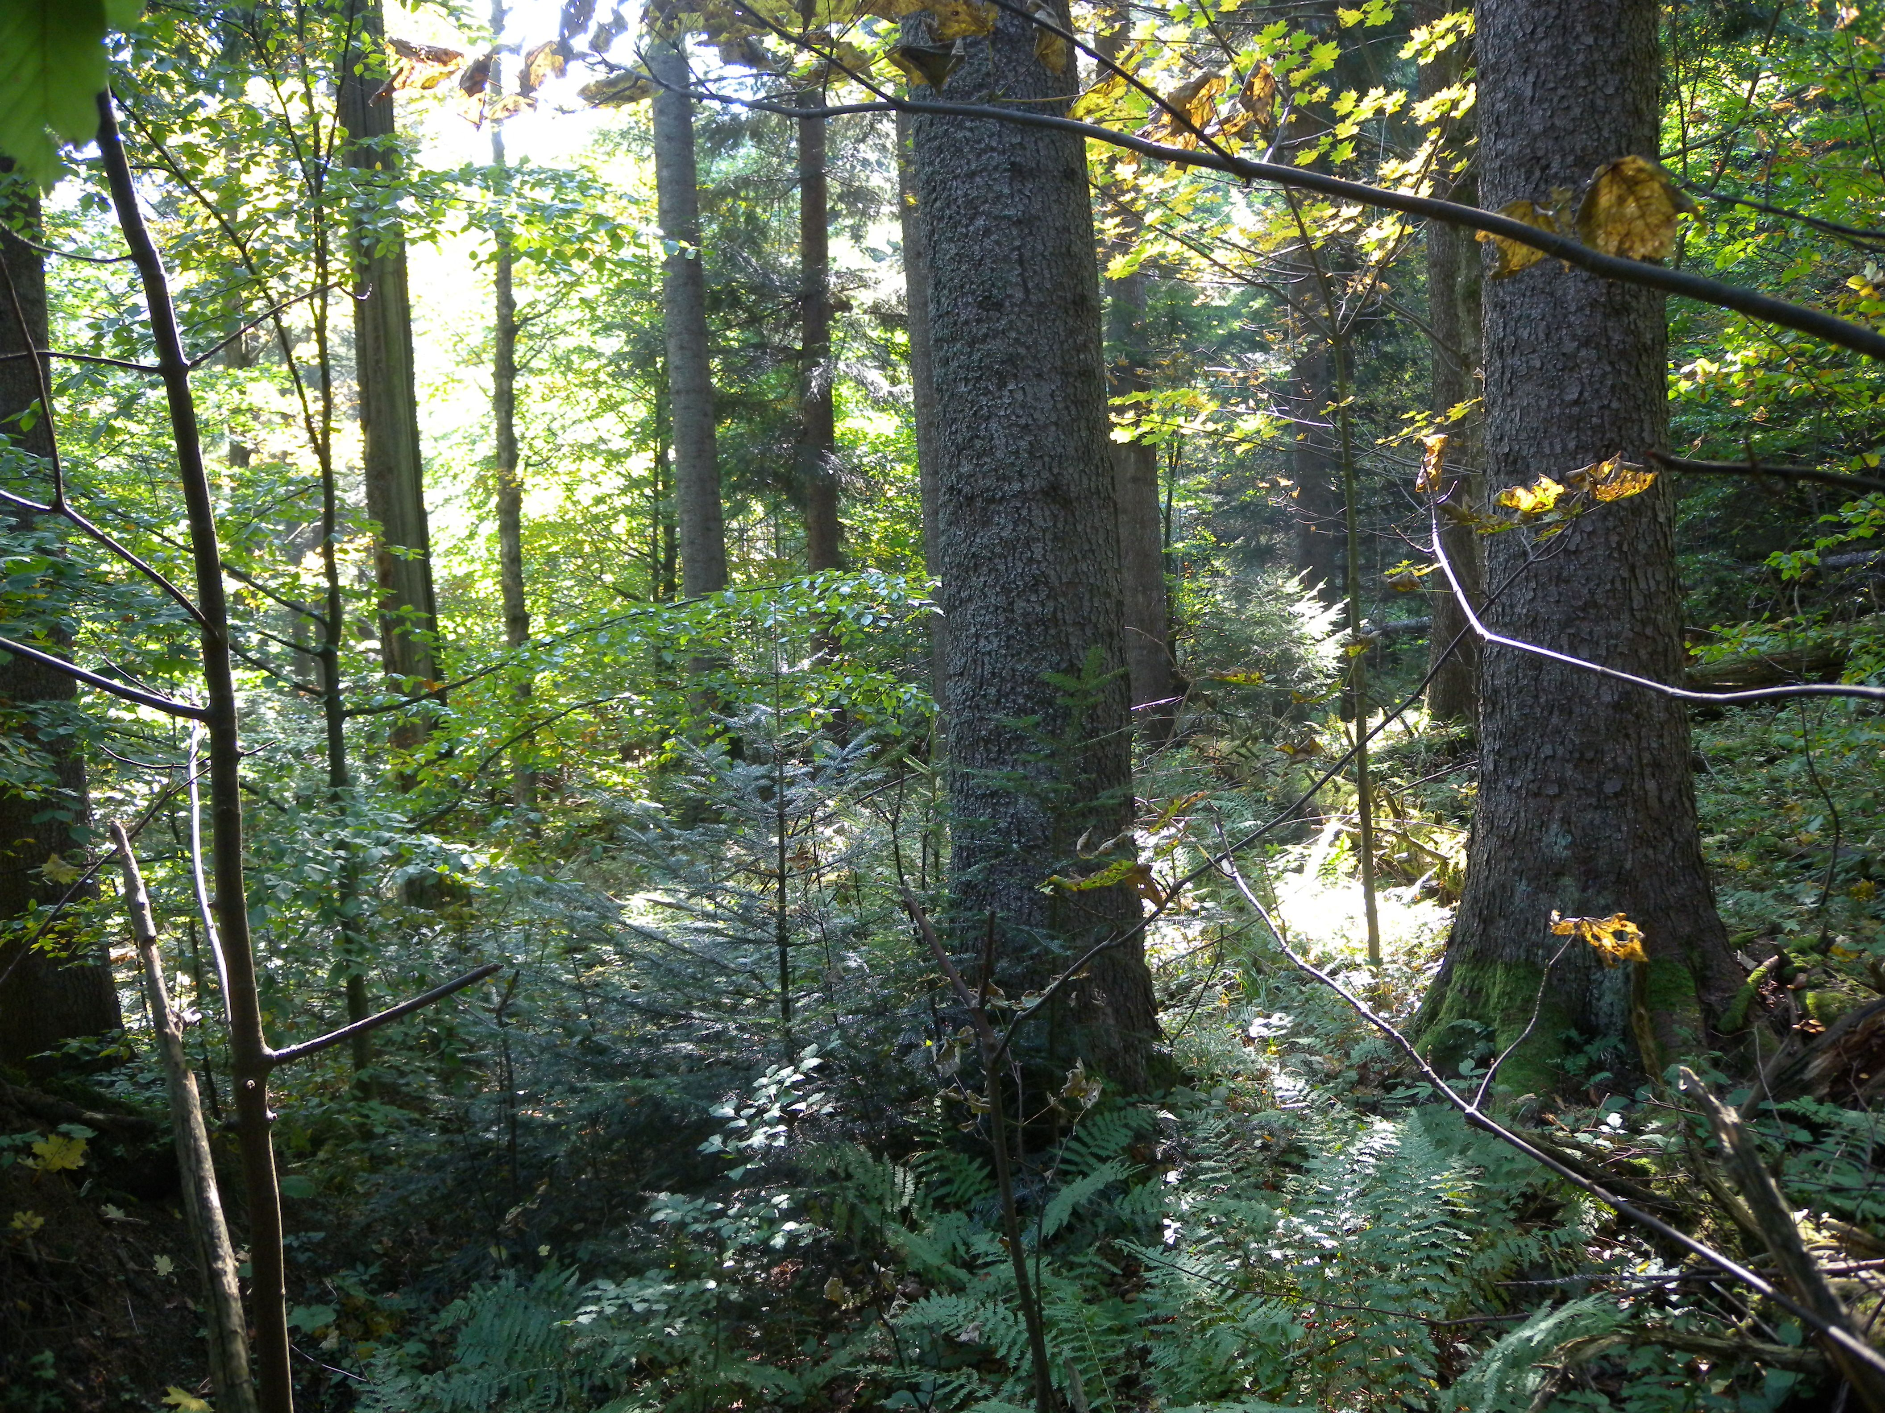
Skole Forest Ukraine
(Сколівські Бескиди)

