Slide 1
THE OTHER SIDE OF THE COIN-: THE RELEVANCE OF INVOLVING MEN IN THE REALISATION OF SRHR IN AFRICA
Dr. Sibusiso Mkwananzi
REGIONAL COLLOQUIUM: The Role of Regional/Sub-Regional Human Rights Bodies in Advancing Sexual and Reproductive Health Rights in Africa
28 June 2018
Johannesburg

Slide 2
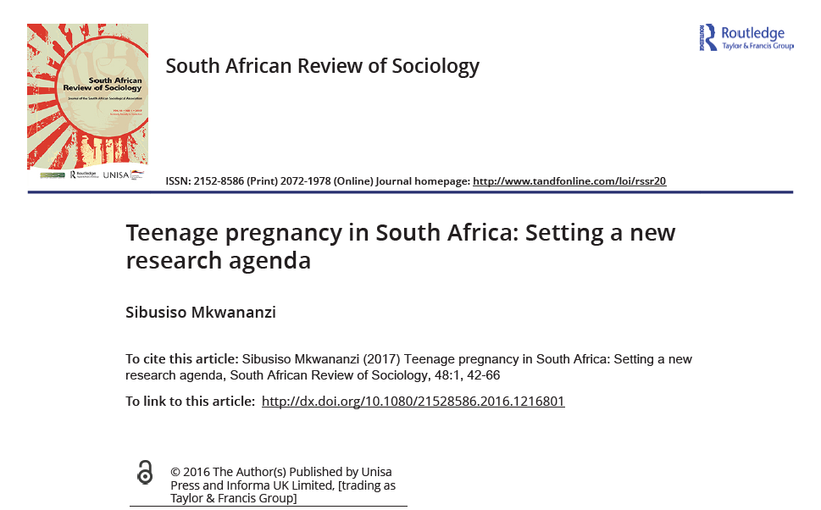
INTRODUCTION
A recent paper entitled:
"Teenage pregnancy in South Africa: Setting a new research agenda"
recommends a complex multilayered approach of researching teenage pregnancy
foregrounds the need of investigating beyond the teenage female:

Slide 3
INTRODUCTION
The author:
Extremely passionate about multi-pronged approach
Forthright in the need to study factors beyond teen girl
Has begun intervention work of advocacy, raising awareness and prevention action research talks on SRH
BUT this very author has since writing this article:
Conducted SRHR talks for young women only
Not engaged with men on SRHR matters
Found it uncomfortable preparing material for mixed gender or male-only audiences

Slide 4
INTRODUCTION
I know this very well because the author in question is ME.
And here ladies and gentlemen lies the conundrum of involving men in SRHR: -
We know we should involve men in SRHR
We say we should involve men in SRHR
And yet we still do not often involve men in SRHR

Slide 5
INTRODUCTION
This paper therefore aimed to explore:
The ways in which men could be involved in SRHR work
What previous studies have found are the benefits and effects of involving men in SRHR work
The barriers that hinder men from accessing and supporting their partners regarding SRHR services?

Slide 6
INTRODUCTION
The 1994 Cairo ICPD Conference:
highlighted the importance of including men in advancing/improving SRHR globally
has led to this need being widely accepted by advocates, educators and policy makers (Stern et al,2015; Jewkes et al, 2015)
Interventions involving men and boys have been proliferated globally-for just over a decade now (Jewkes et al, 2015)

Slide 7
In what ways could men be involved in SRHR work?
Three areas to consider as proposed by the male involvement model of Green et al.(2006)
MEN AS CLIENTS
Argues the need to increase the number of men accessing SRH services
Ensuring the presence of SRH infrastructure that targets men, including policies, services and opening hours
Services would include: SRH knowledge, Family planning, HIV and other STI testing, VMMC, Urologist referral for complicated cases, Prostate check-ups

Slide 8
In what ways could men be involved in SRHR work?
MEN AS EQUAL PARTNERS
Argues the need to educate and increase awareness among men to ensure optimal SRHR for their partners
Involves:
Advocacy and education via workshops, posters and community dialogues
To change gender inequitable attitudes and perceptions among men;
To eliminate the tolerance of violence against women and teach men the SRH rights that women have (external and internal to relationship)
Aims to increase:
Communication about sexual decision-making and choosing family planning options,
Supporting women's initiation of contraception,
Escorting their partners to access SRHR services, antenatal care as well as postnatal care

Slide 9
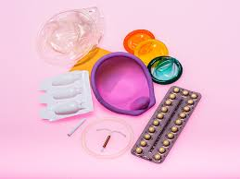
In what ways could men be involved in SRHR work?
MEN AS ADVOCATES OF CHANGE
Argues the need to educate and increase awareness among men that supports men to mobilise other men's involvement in sexual and reproductive health
Seems to be the greatest challenge, but linked to first two issues

Slide 10
What have previous studies found as the effects of involving men in SRHR work?
Improving men's sexual health: increasing condom use, delaying sexual debut, decreasing likelihood of multiple concurrent sexual partners
Promoted gender equality and open sexual decision making between partners
Decreased tolerance to GBV leading to increased willingness and responsibility to do domestic chores
Increased discussion with partners about reproductive planning
Increased support of partner's needs
Increased escorting of partners to clinic to access SRH

Slide 11
What have previous studies found as the effects of involving men in SRHR work?
Increased maternal and child health:
Reduced preterm births, low birth weight, foetal growth restriction, infant mortality, maternal stress
Improved maternal workload during pregnancy,
birth preparedness,
Increased uptake of antenatal and postnatal care
Increased couple communication,
Increased use of family planning and contraceptives
Increased healthy termination of pregnancy management
Prevention of STI & HIV/AIDS
Stronger bonds between men and their offspring

Slide 12
What are the barriers that hinder men?
Barriers at Individual-level
Lower education levels;
Low income;
Limited awareness regarding the roles of men in SRH;
These are the characteristics that researchers and programme implementers should consider when choosing to whom and where to start programmes as they may have the most effect among such groups

Slide 13
What are the barriers that hinder men?
Barriers at Societal/Community level
Health facility -related factors- e.g. unfavourable attitudes from staff, lack of male-service packages
Negative perceptions, attitudes and beliefs of men in communities towards reproductive health
Single-focus interventions less effective compared to multi-pronged approach to change behaviour among men and boys
Overcoming the above issues will need a multi-sector approach

Slide 14
THANK YOU !
QUESTIONS!
Sibusiso.Mkwananzi@wits.ac.za

